Slide 1

CAPSTONE PROJECT - Sports analysis
By Saisha Hemrajani

Slide 2
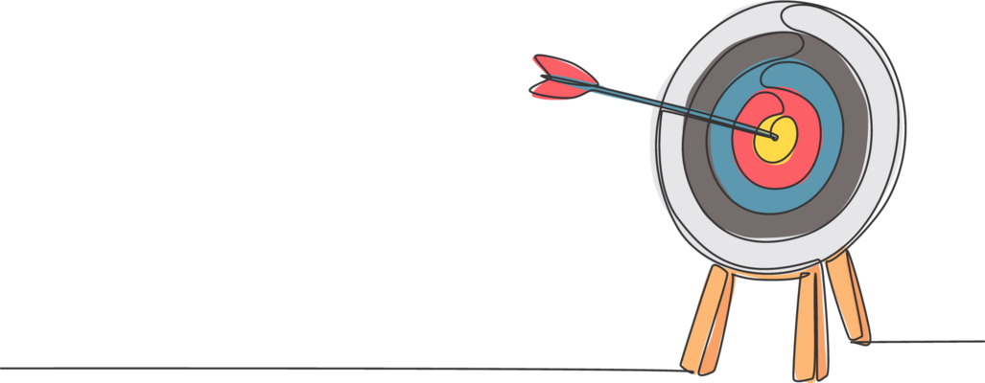
OBJECTIVE
Dataset Description
To carry out a systematic analysis of historical Olympic Games data (from 1896 to 2020) to uncover patterns, trends, and relationships across different dimensions of the Games.
By utilizing organized data concerning athletes, events, sports, regions, and medals, the research seeks to answer significant analytical questions related to participation, performance, and representation.
Utilized a combination of SQL-based queries, Excel, and Power BI visualizations for the analysis

Slide 3

Dataset Description
The dataset described is a thorough collection of information about the Olympic Games, offering a detailed perspective on different aspects associated with this prestigious international sporting event.
It encompasses data from multiple interconnected tables, delivering valuable insights into the history, sports, participants, and venues of the Olympic Games.

Slide 4
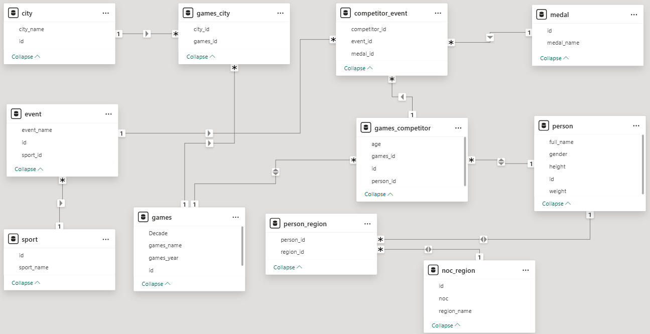
ER DIAGRAM

Slide 5



Slide 6
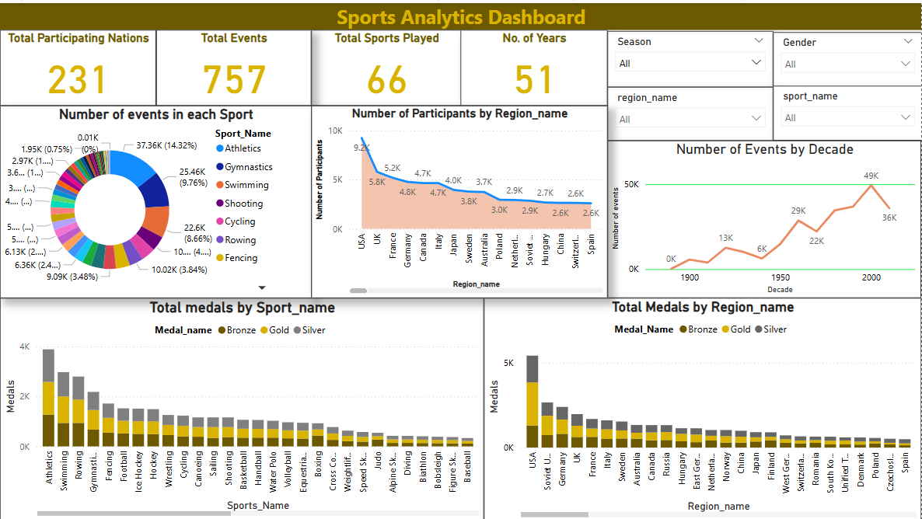

Slide 7
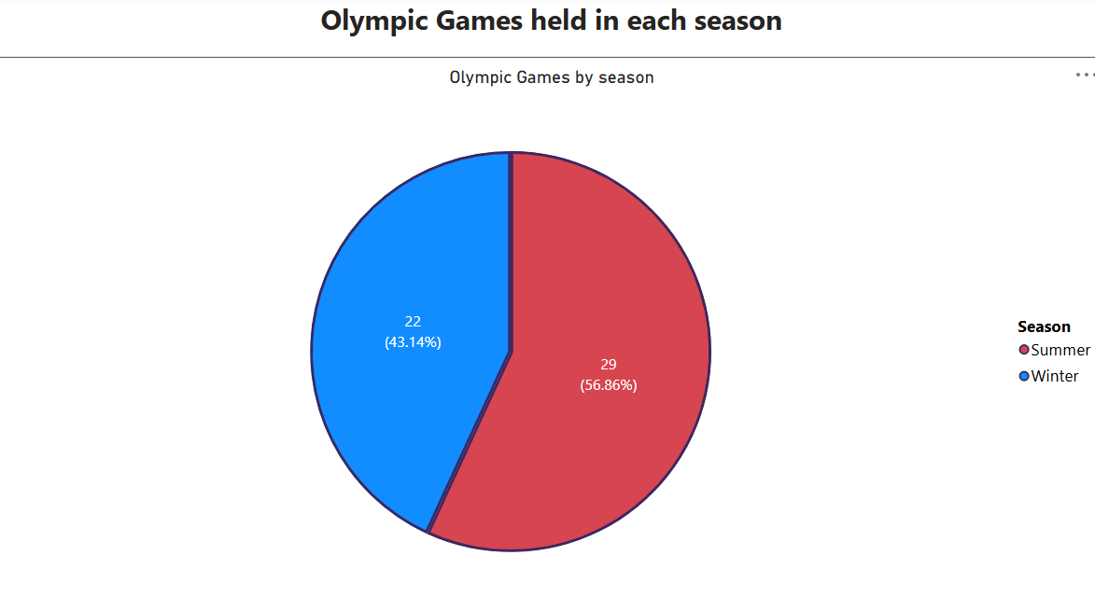
1.How many Olympic Games have been held in each season (Summer vs. Winter)?
Upon observing this pie-chart, it is clearly seen that a greater number of Olympic Games have been held in the Summer season compared to the Winter season.
Summer season had 29 games and Winter had 22 games.

Slide 8
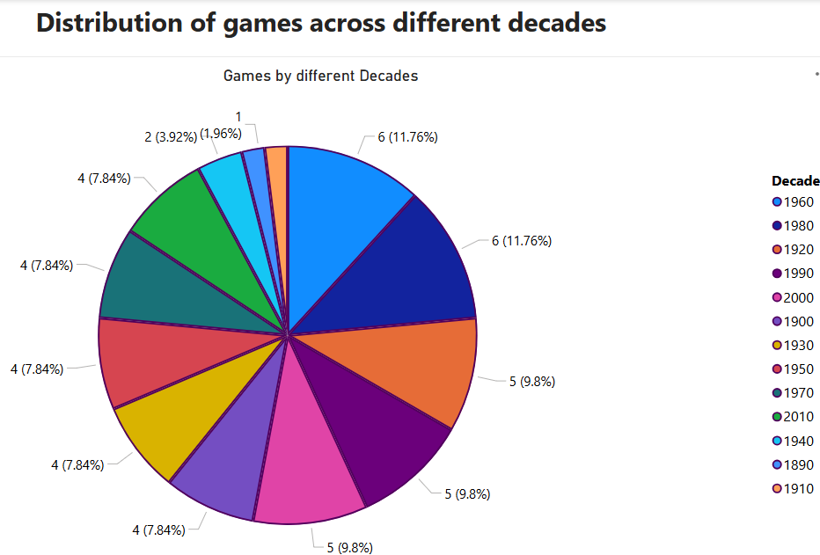
2. What is the distribution of games across different decades?
The Olympic Games have seen consistent growth across decades, with notable drops during the 1910s and 1940s due to World Wars.
The maximum games were played in 1960 and in 1980.

Slide 9
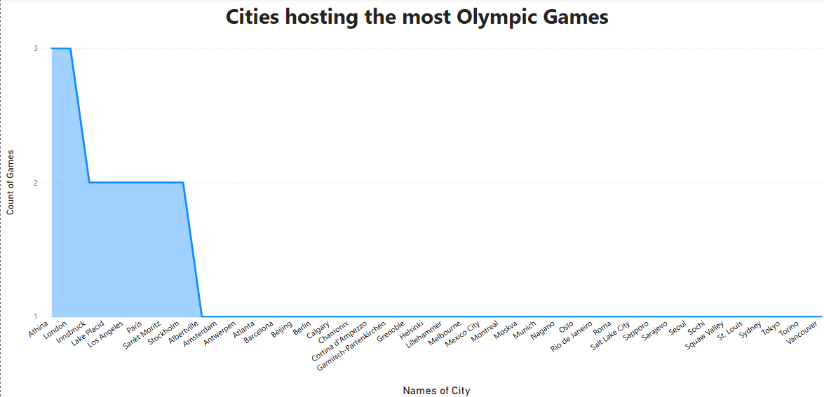
3. Which cities have hosted the most Olympic Games?
From the “Stacked Area Chart” it can be observed that both London and Athina have hosted the maximum number (3 times) of Olympic games.
Cities like Innsbruck, Lake Placid, Los Angeles, Paris, Sankt Moritz and Stockholm have hosted twice.

Slide 10
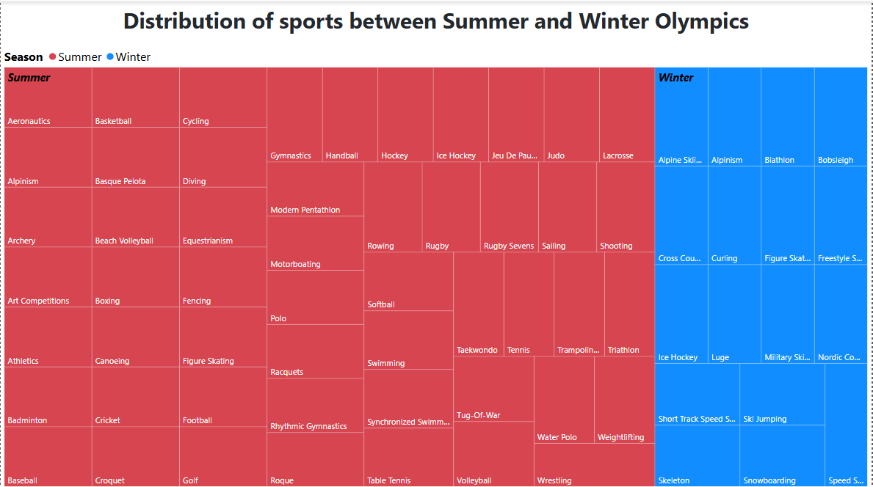
4. What is the distribution of sports between Summer and Winter Olympics?
The TreeMap shows that the Summer Olympics include a significantly larger variety of sports compared to the Winter Olympics.
This reflects broader global participation and more accessible sporting disciplines in summer, while winter sports are more niche and climate-dependent.

Slide 11
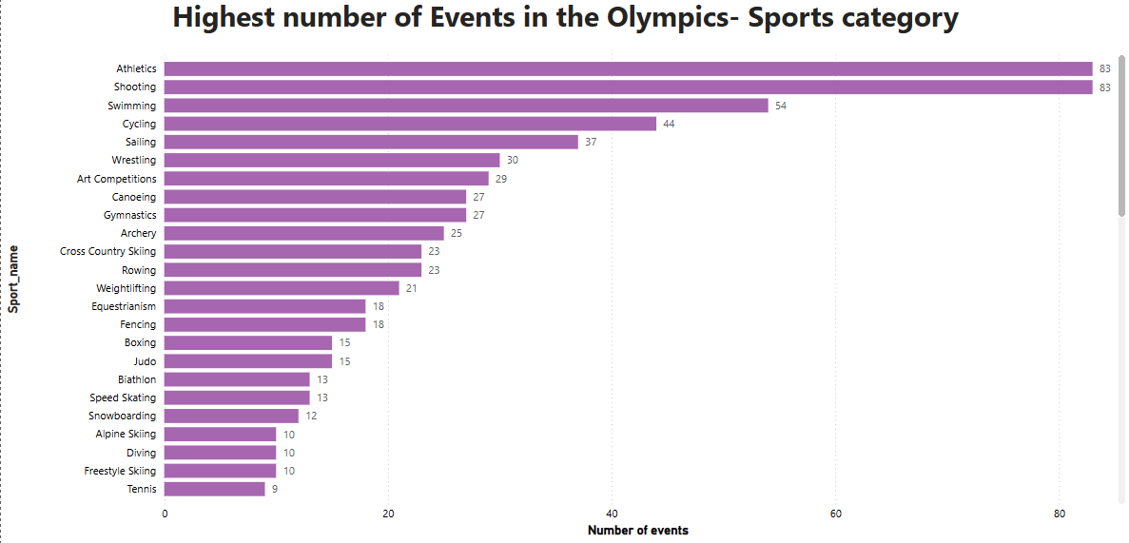
5.Which sports have the highest number of events in the Olympics?
This Clustered Bar Chart reveals that both Athletics and Shooting have highest number of sports- i.e 83 in the entire Olympics game starting from 1896.

Slide 12
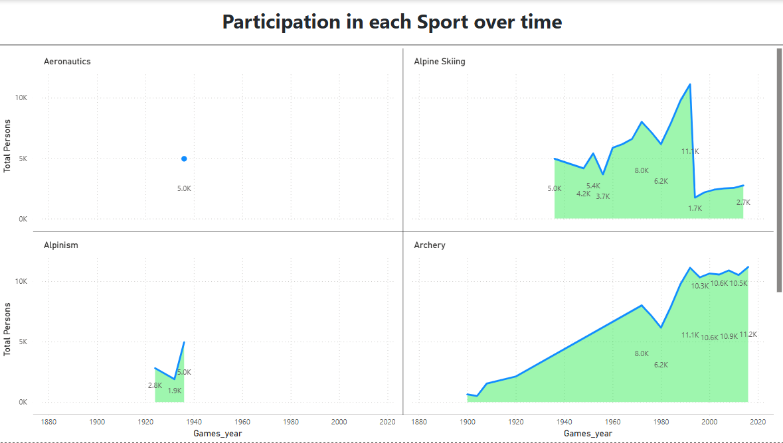
6. How has the participation in each sport evolved over time?
This multiple Stacked Area Chart indicates that participation in most sports has increased over time

Slide 13
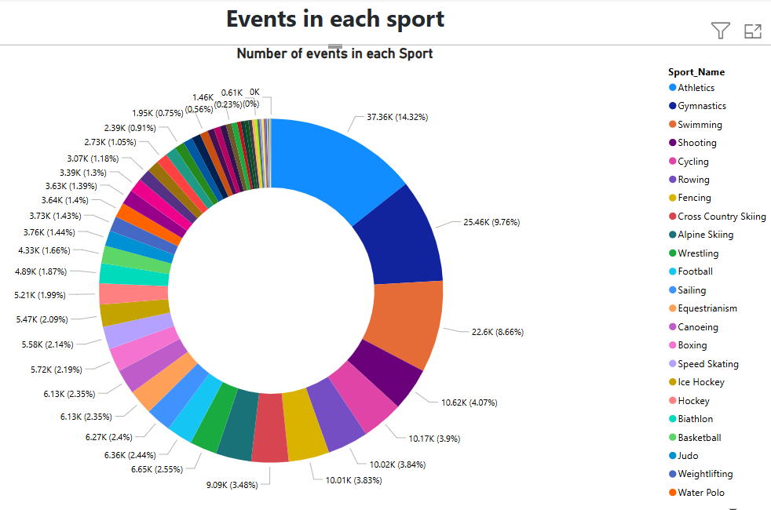
7.How many events are there in each sport?
The Donut Chart shows that the number of events varies significantly across sports, with disciplines like Athletics (14.32%), Gymnastics (9.76%) and swimming (8.66%) as Top3.

Slide 14
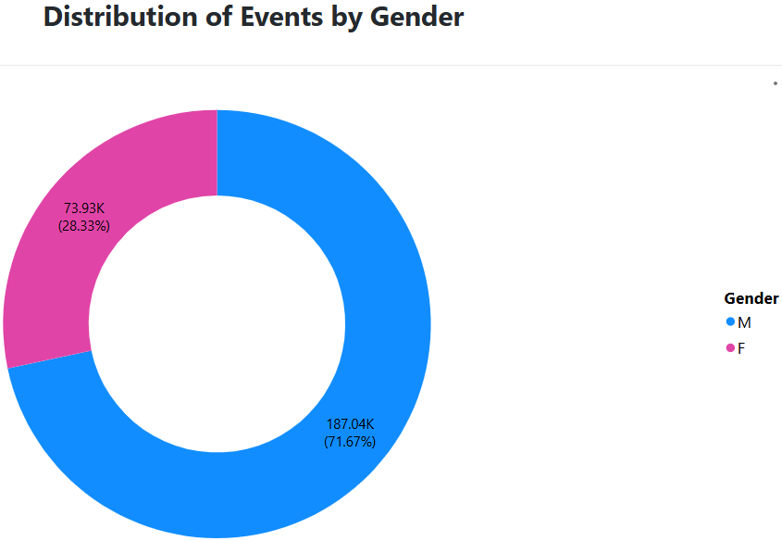
8. What is the distribution of events by gender (Men, Women, Mixed)?
While men’s events historically dominated, the number of women’s has steadily increased, especially in recent editions. While no data was found for Mixed gender, we may see it in the future games.

Slide 15
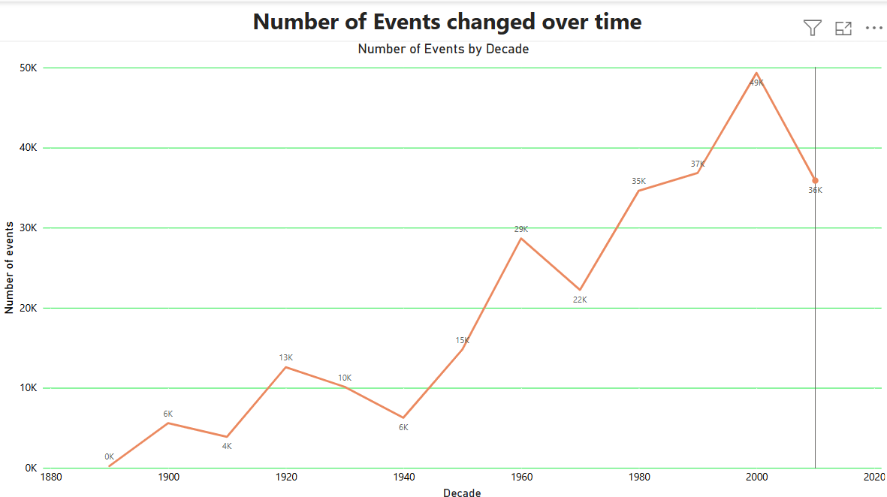
9. How has the number of events changed over time?
The Line Chart representation detects that the number of Olympic events has steadily increased over time, owing to the addition of new sports and disciplines.
Highest was in 2000 Summer Olympics – 13,815 events and lowest was in 1896 Summer Olympics- 217 events.

Slide 16
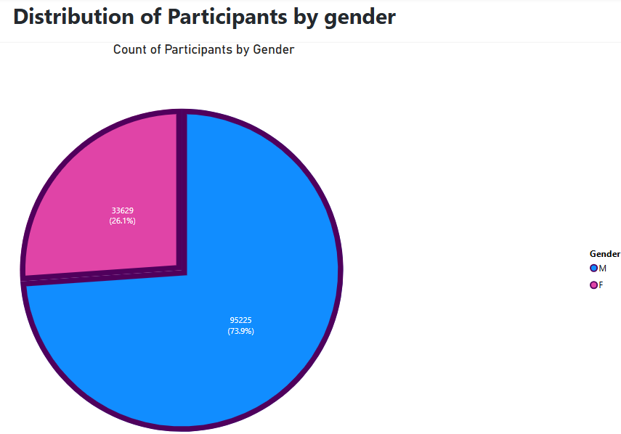
10. What is the distribution of participants by gender?
The pie-chart states that male participants are dominant – 73% than females.
However, the gender gap has narrowed significantly in recent decades.

Slide 17
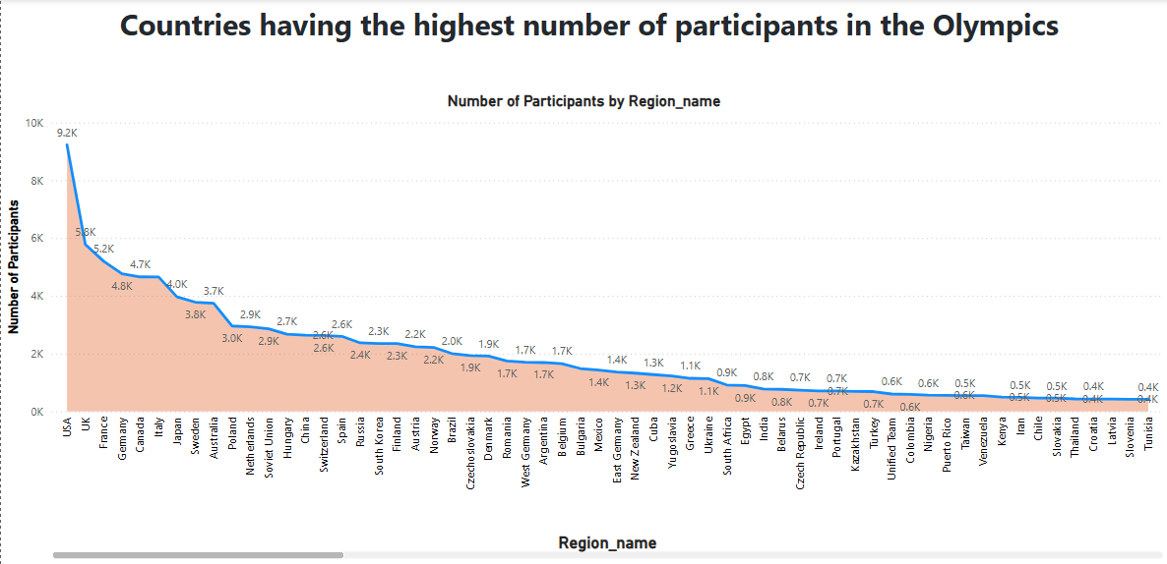
11. Which countries have the highest number of participants in the Olympics?
Total participation in entire 51 years of Olympics was 135571.
The Area Chart mentions that United States has the highest participation record of 9225, followed by United Kingdom – 5783.
The chart also reveals countries like Somania, Yemen, Qatar, Nepal have hardly 1 person participation.

Slide 18
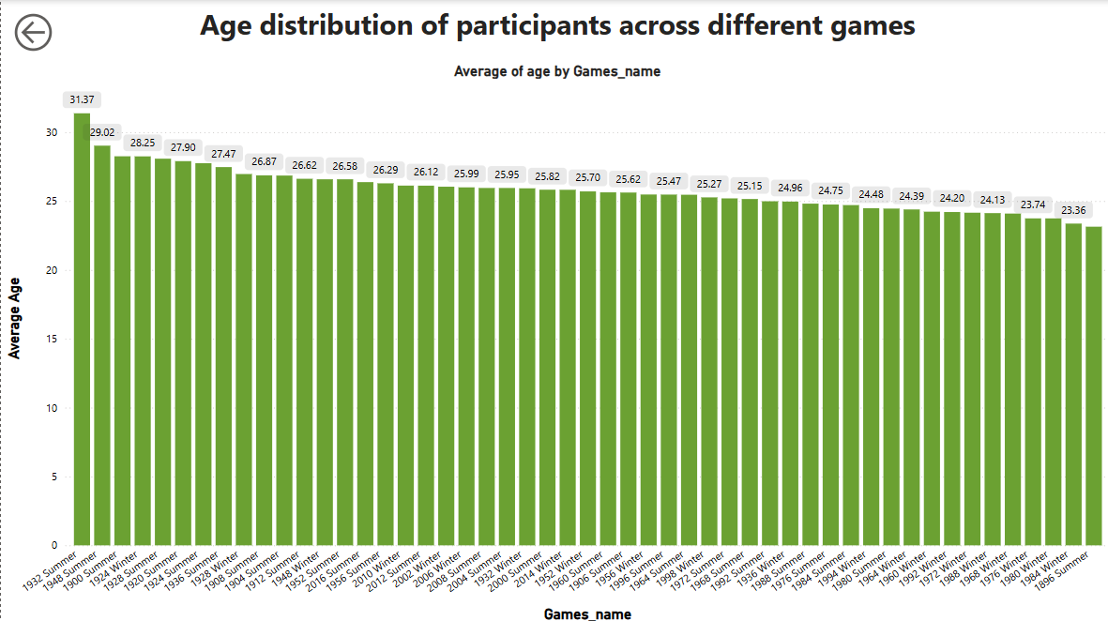
12.How does the age distribution of participants vary across different games?
The age of the participants ranges from 10 to 97.
The Clustered Column Chart age distribution of Olympic participants varies across different average ages from 23yrs old to 31yrs old.

Slide 19
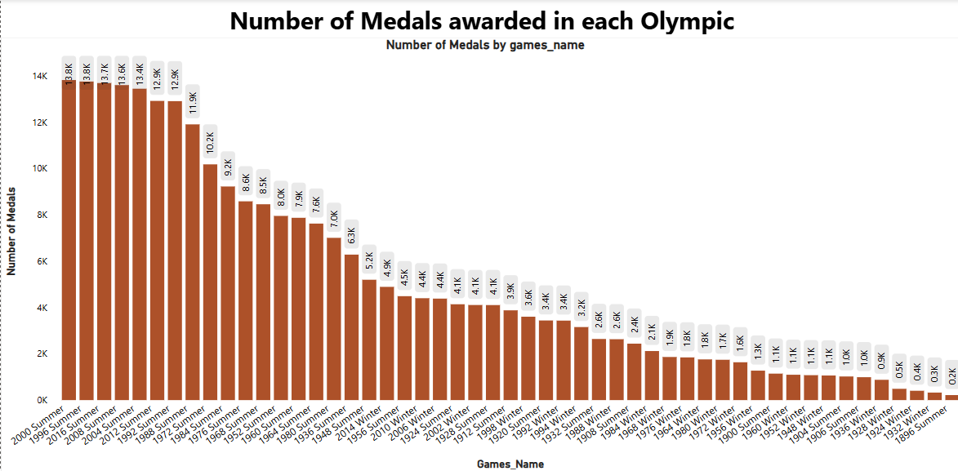
13. How many medals have been awarded in each Olympics?
From this Clustered Column chart- The number of medals awarded has steadily increased over the years, with recent Summer Olympics (2008–2016) awarding the highest number of medals — over 13,815 per edition,

Slide 20
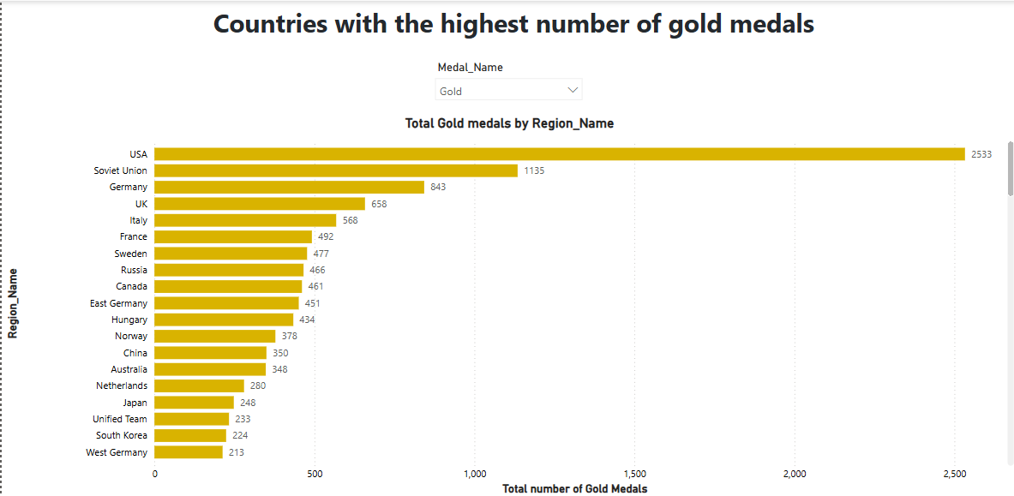
14. Which countries have the highest number of gold medals?
As we can see from the Clustered Bar Chart that The United States leads overwhelmingly with 2,533 gold medals, more than double that of the second-highest country. This reflects consistent excellence across multiple sports and Olympic editions.

Slide 21
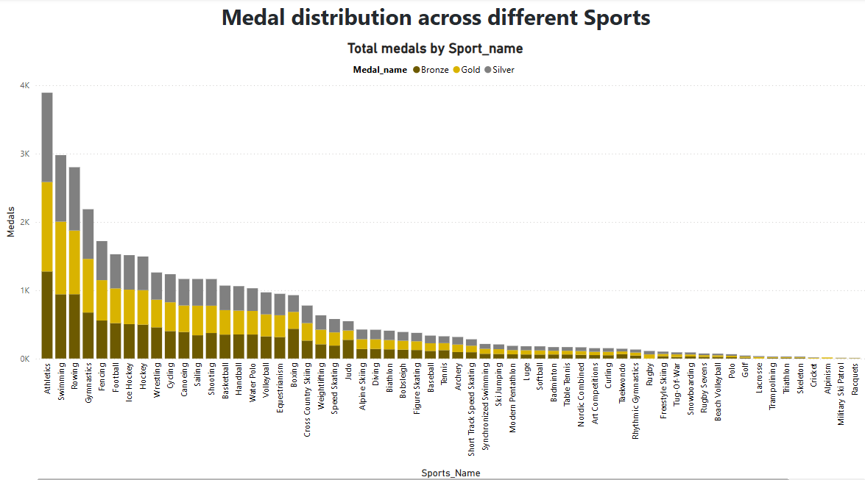
15.How does the medal distribution vary across different sports?
As we can see from the Stacked Column Chart that Athletics leads by a significant margin with the highest number of total medals (3892), followed by Swimming and Rowing.

Slide 22
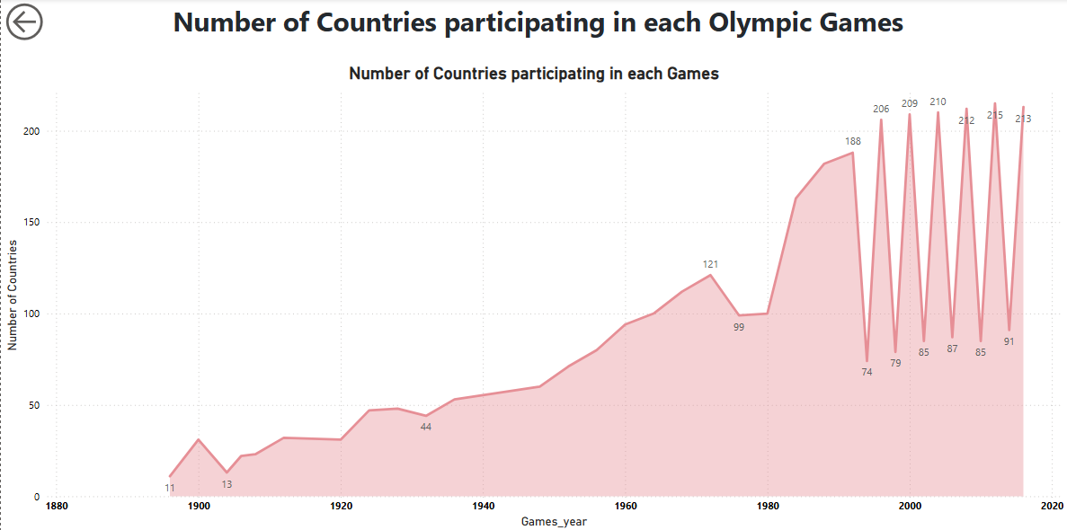
16.How many regions or NOCs participate in each Olympic Games?
Total 231 nations participated till date.
From the Line Chart, it showcases the steadily increasing number of participating countries that signifies enhanced global cooperation, geopolitical changes, and the Olympic movement’s success in fostering inclusivity.

Slide 23
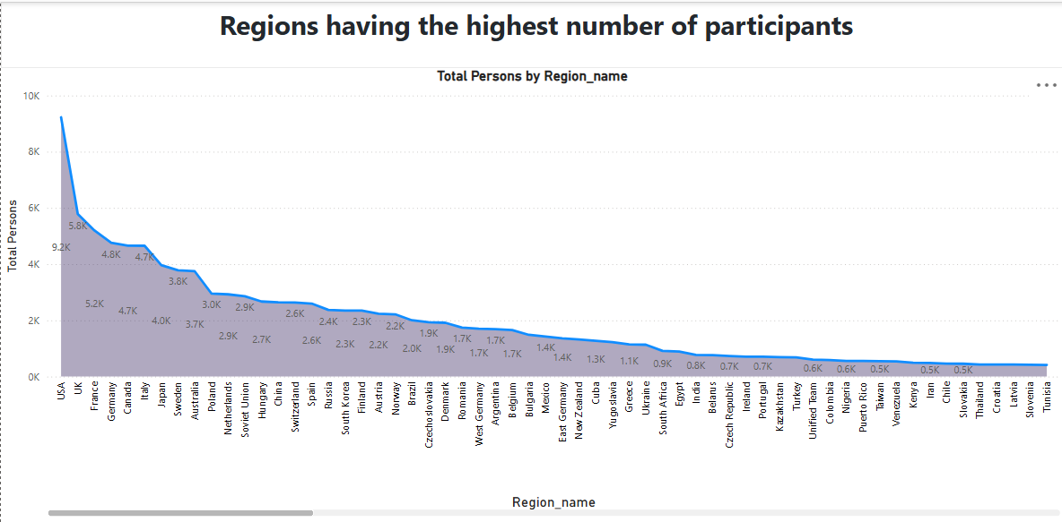
17. Which regions have the highest number of participants in the Olympics?
As per the above Stacked Area Chart, USA has the highest number of participants- 9225.

Slide 24
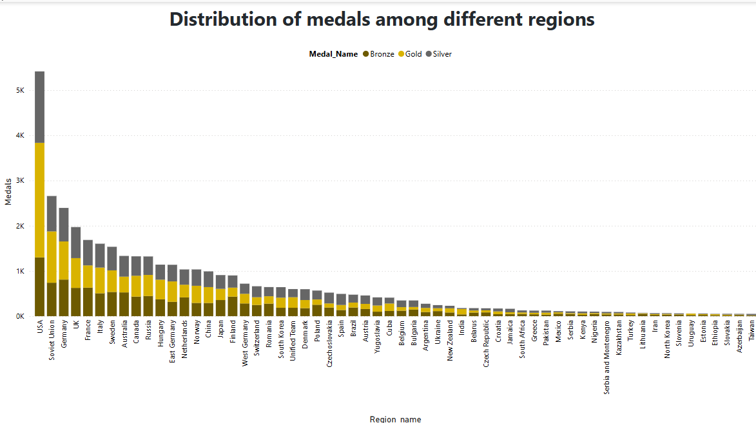
18. What is the distribution of medals among different regions?
As we can see from the Stacked Column Chart that The United States has earned the highest number of Olympic medals, surpassing 5,000 total medals, with a balanced distribution across Gold, Silver, and Bronze. Gold being the highest!

Slide 25

PROBLEM STATEMENTS

Slide 26


Slide 27
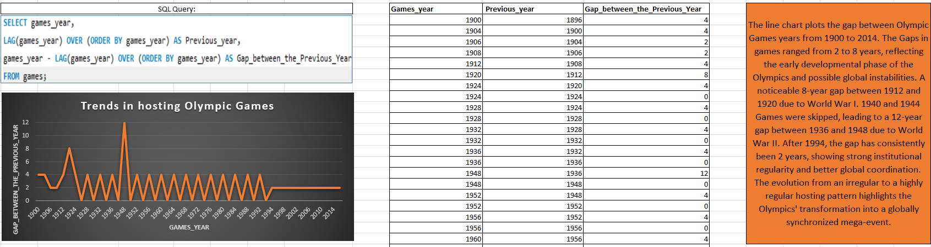
1. Are there any trends or patterns in the frequency of hosting Olympic Games?
Yes, The line chart plots the gap between Olympic Games years from 1900 to 2014. The Gaps in games ranged from 2 to 8 years, reflecting the early developmental phase of the Olympics and possible global instabilities. A noticeable 8-year gap between 1912 and 1920 due to World War I. 1940 and 1944 Games were skipped, leading to a 12-year gap between 1936 and 1948 due to World War II.

Slide 28
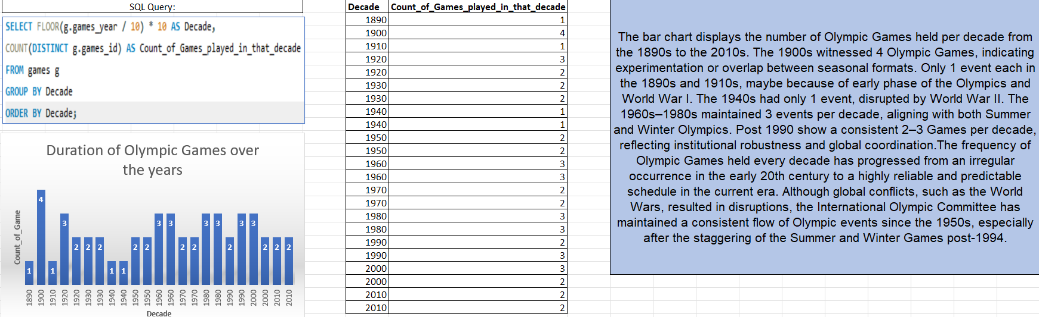
2. How has the duration of Olympic Games changed over time?
The bar chart displays the number of Olympic Games held per decade from the 1890s to the 2010s. The 1900s witnessed 4 Olympic Games, indicating experimentation or overlap between seasonal formats. Only 1 event each in the 1890s and 1910s, maybe because of early phase of the Olympics and World War I. The 1940s had only 1 event, disrupted by World War II.
.

Slide 29
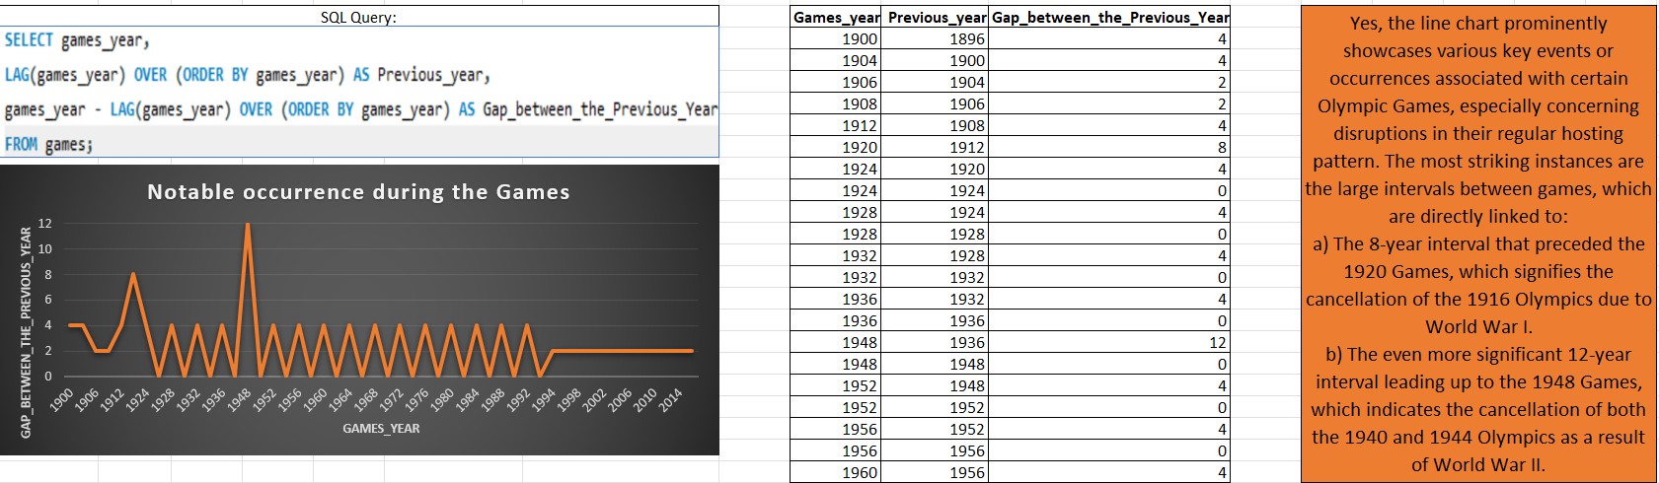
3. Are there any notable events or occurrences associated with specific Olympic Games?
a) The 8-year interval that preceded the 1920 Games, which signifies the cancellation of the 1916 Olympics due to World War I.
b) The even more significant 12-year interval leading up to the 1948 Games, which indicates the cancellation of both the 1940 and 1944 Olympics as a result of World War II.

Slide 30
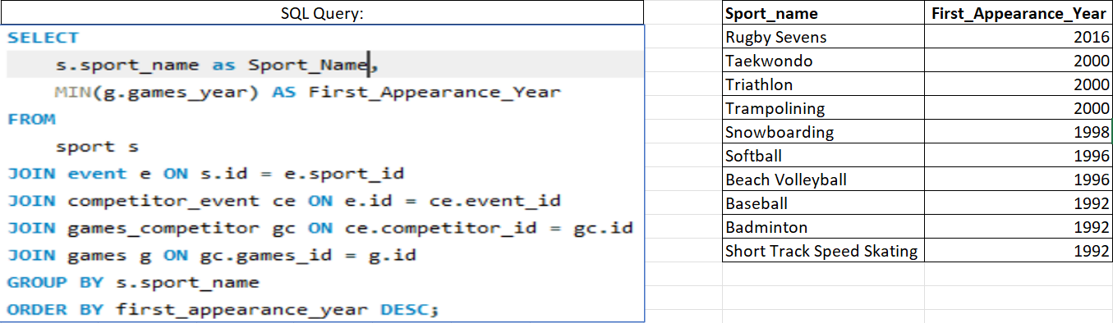
4. Are there any emerging sports that have been recently added to the Olympics?
Only 10 sports were introduced 1992 and 2016. .The Olympic Games have strategically expanded their sports portfolio to include emerging, fast-paced, and youth-oriented events.

Slide 31
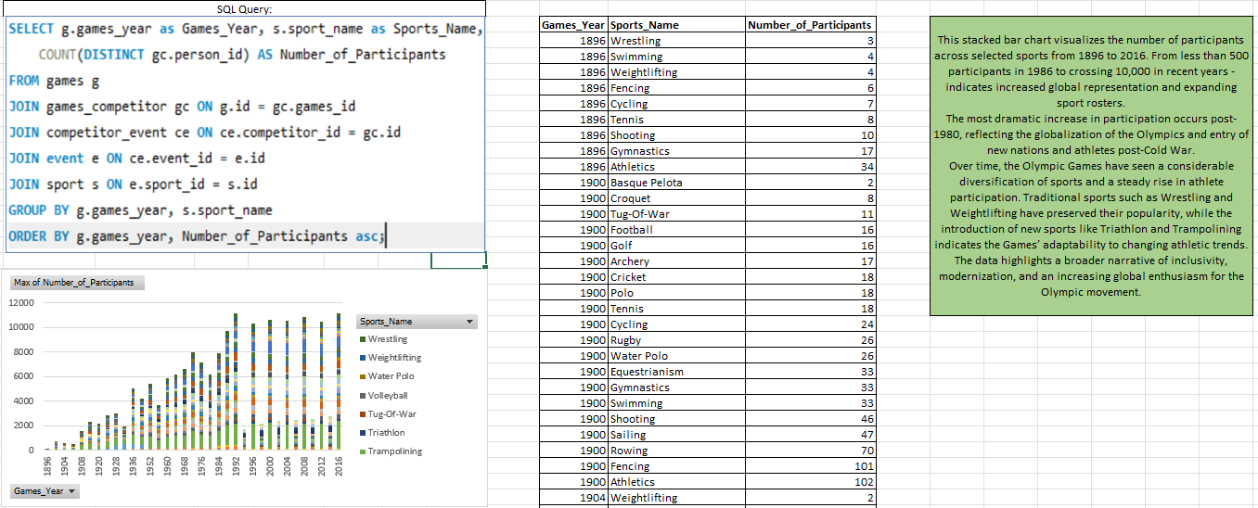
5. How has the popularity of certain sports changed over the years?
This stacked bar chart visualizes the number of participants across selected sports from 1896 to 2016. From less than 500 participants in 1986 to crossing 10,000 in recent years - indicates increased global representation and expanding sport rosters.

Slide 32
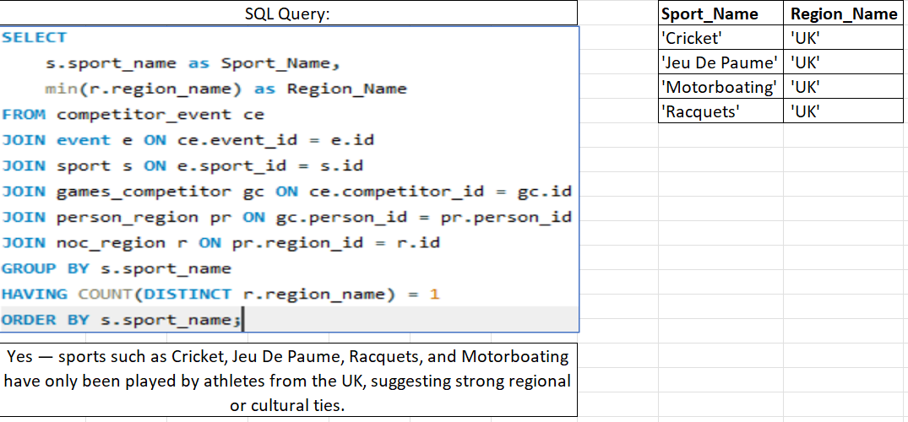
6. Are there any sports that are specific to a particular region or culture?
Yes — sports such as Cricket, Jeu De Paume, Racquets, and Motorboating have only been played by athletes from the UK, suggesting strong regional or cultural ties.

Slide 33
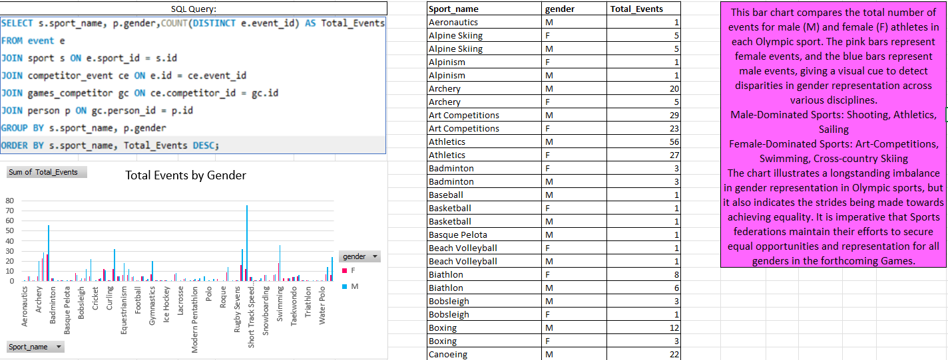
7. Are there any sports that have a higher number of events for one gender compared to others?
Male-Dominated Sports:
Shooting, Athletics, Sailing
Female-Dominated Sports: Art-Competitions, Swimming, Cross-country Skiing

Slide 34
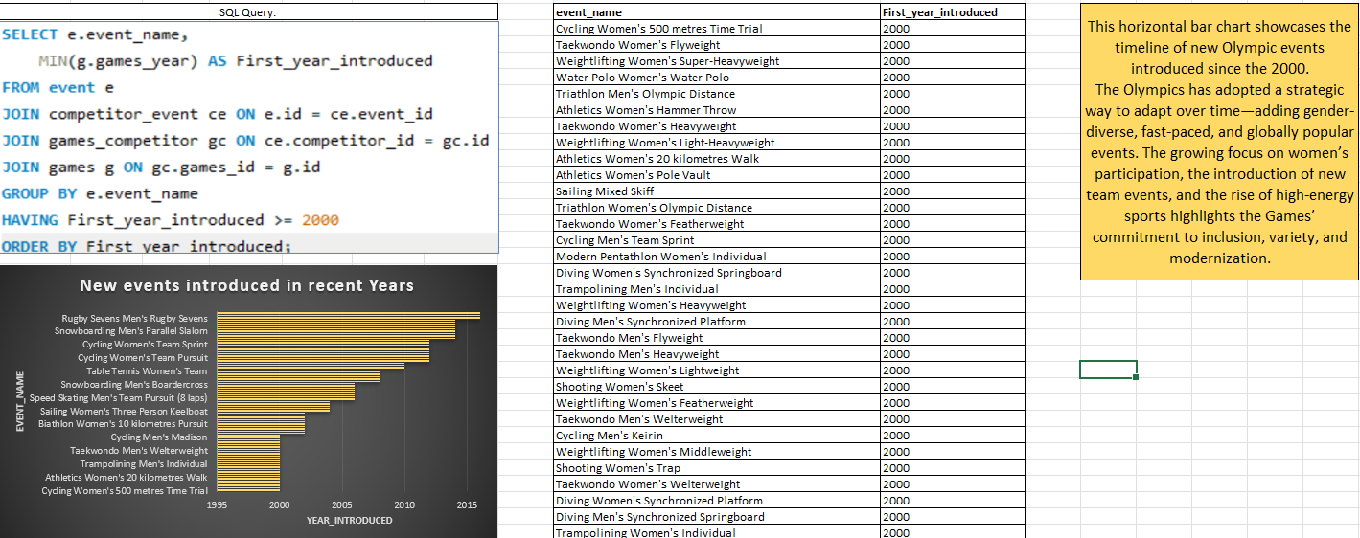
8. Are there any new events that have been introduced in recent editions of the Olympics?
This horizontal bar chart showcases the timeline of new Olympic events introduced since the 2000.
The Olympics has adopted a strategic way to adapt over time—adding gender-diverse, fast-paced, and globally popular events.

Slide 35
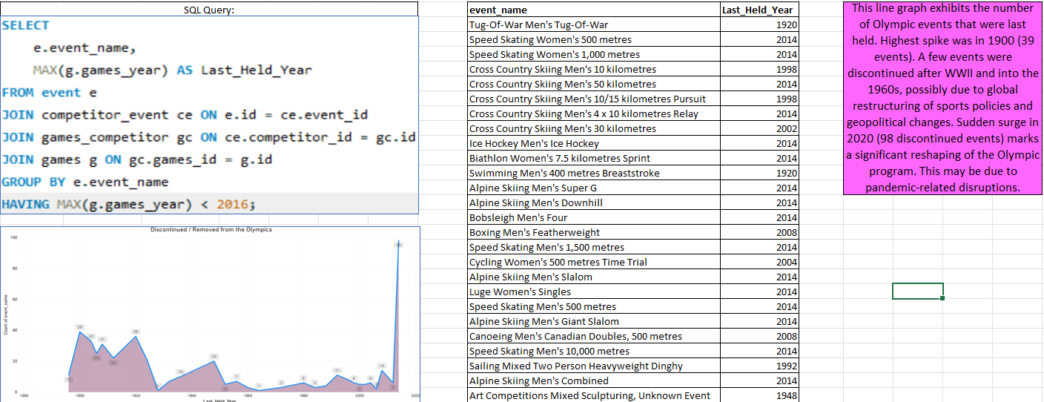
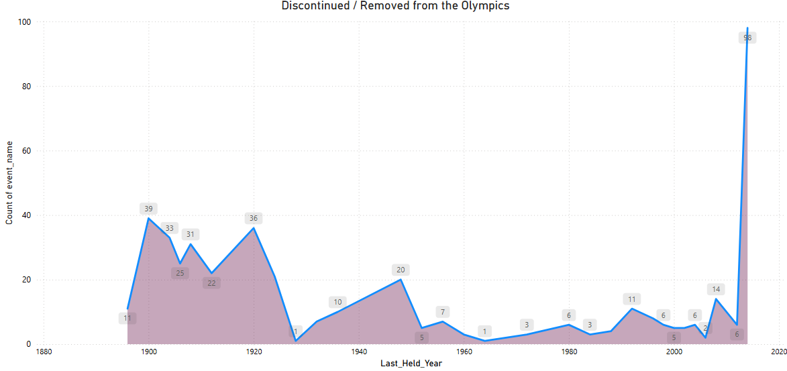
9. Are there any events that have been discontinued or removed from the Olympics?
This line graph exhibits the number of Olympic events that were last held. Highest spike was in 1900 (39 events).
Sudden surge in 2020 (98 discontinued events) marks a significant reshaping of the Olympic program. This may be due to pandemic-related disruptions

Slide 36
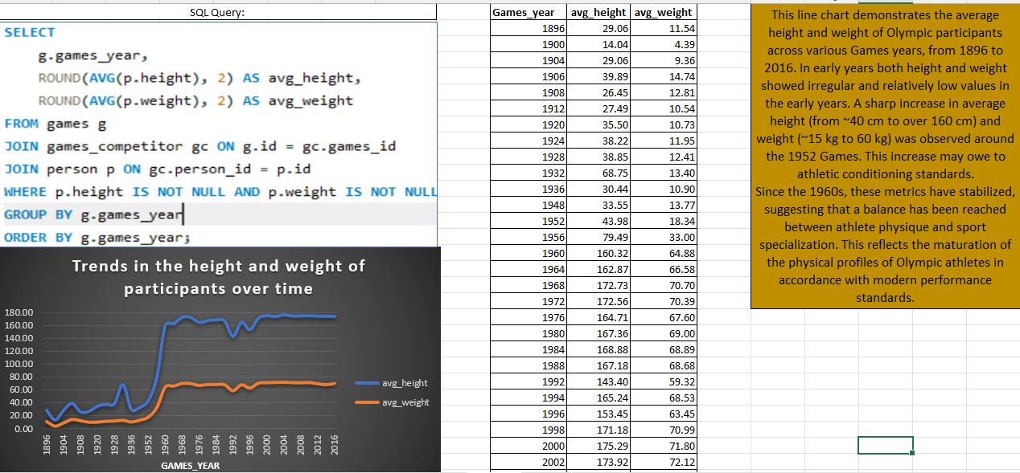
10. Are there any notable trends in the height and weight of participants over time?
This line chart demonstrates the average height and weight of Olympic participants across various Games years, from 1896 to 2016.
Since the 1960s, these metrics have stabilized, suggesting that a balance has been reached between athlete physique and sport specialization. This reflects the maturation of the physical profiles of Olympic athletes in accordance with modern performance standards.

Slide 37
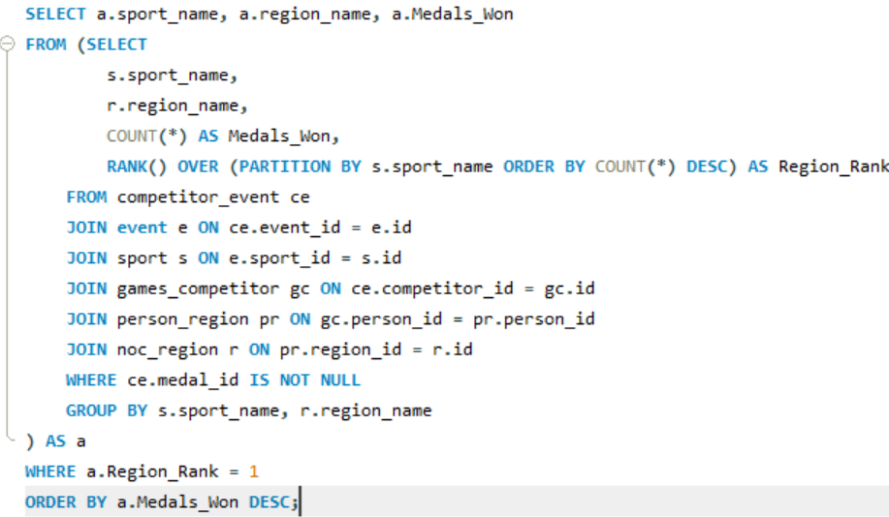
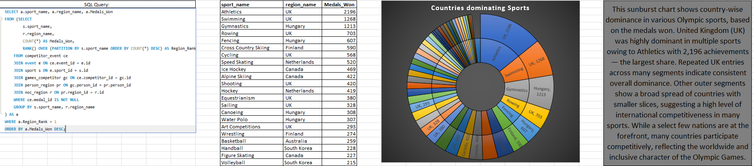
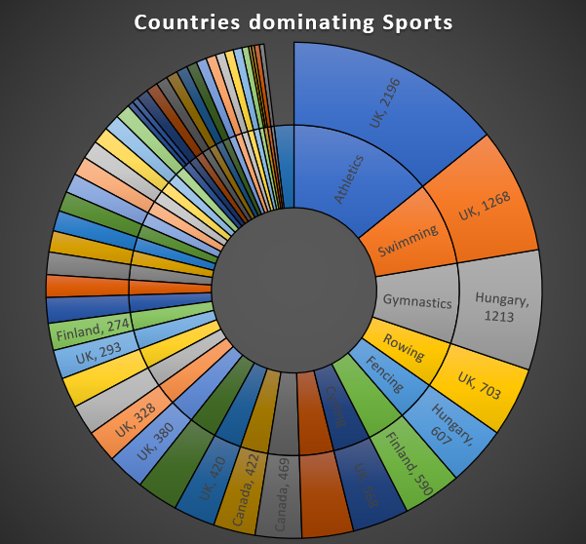
11. Are there any dominant countries or regions in specific sports or events?
This sunburst chart shows country-wise dominance in various Olympic sports, based on the medals won. United Kingdom (UK) was highly dominant in multiple sports owing to Athletics with 2,196 achievements — the largest share.
Repeated UK entries across many segments indicate consistent overall dominance. Other outer segments show a broad spread of countries with smaller slices, suggesting a high level of international competitiveness in many sports.

Slide 38
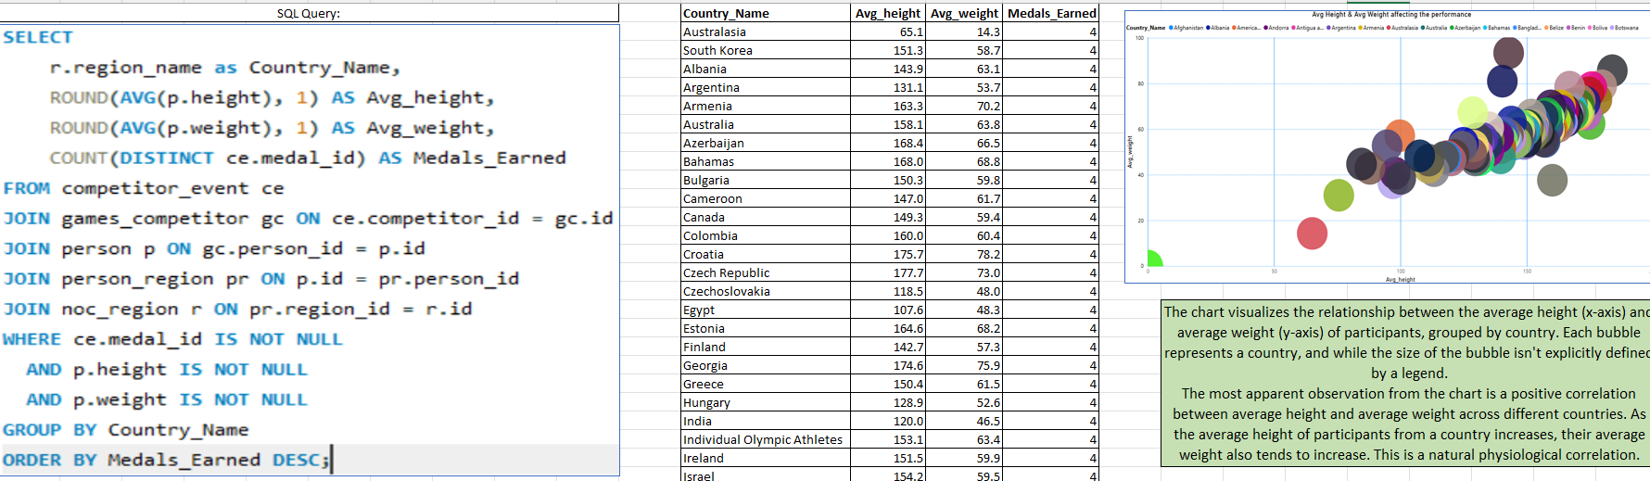
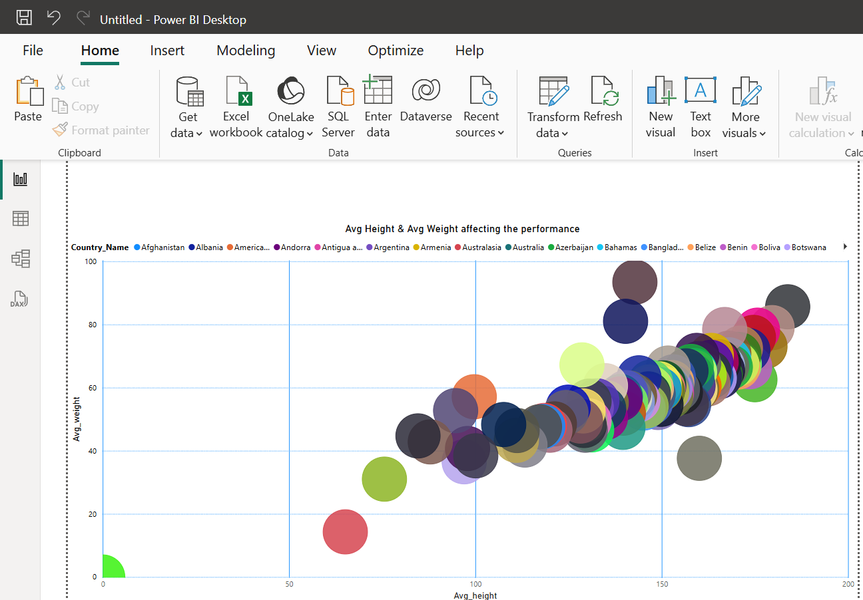
12.What factors contribute to the success or performance of participants from different countries?
The most apparent observation from the chart is a positive correlation between average height and average weight across different countries. As the average height of participants from a country increases, their average weight also tends to increase. This is a natural physiological correlation.

Slide 39
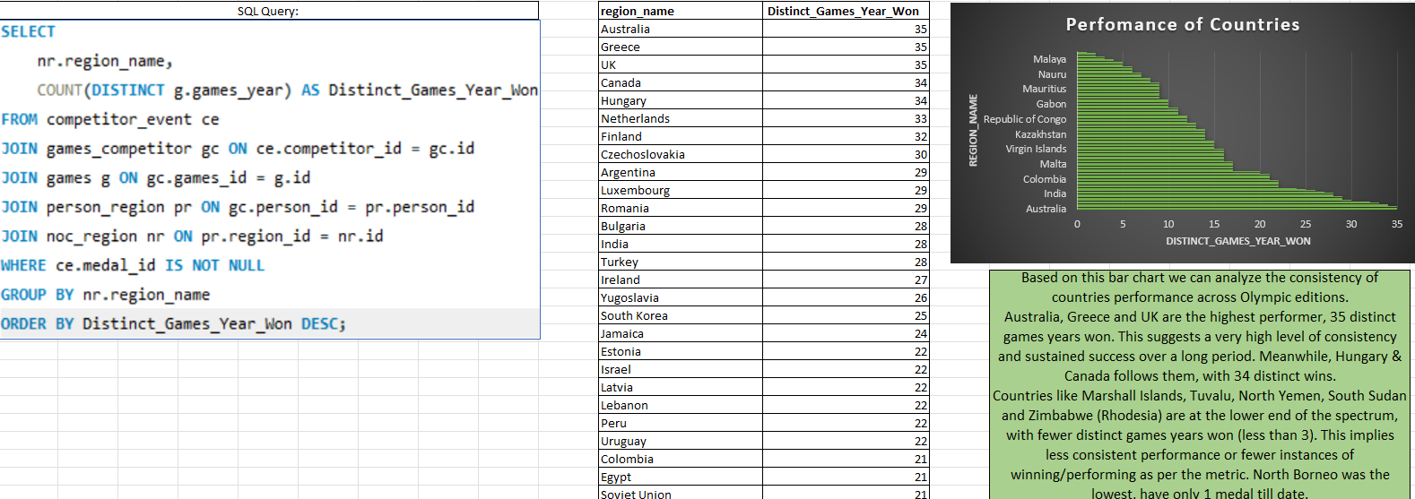
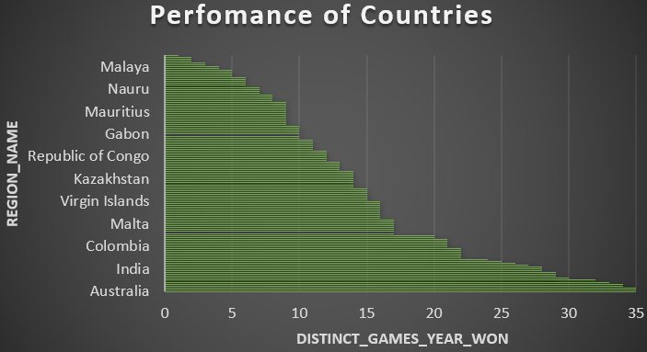
13.Are there any countries that consistently perform well in multiple Olympic editions?
Australia, Greece and UK are the highest performer, 35 distinct games years won. This suggests a very high level of consistency and sustained success over a long period. Meanwhile, Hungary & Canada follows them, with 34 distinct wins.
Countries like Marshall Islands, Tuvalu, North Yemen, South Sudan and Zimbabwe (Rhodesia) are at the lower end of the spectrum, with fewer distinct games years won (less than 3).

Slide 40
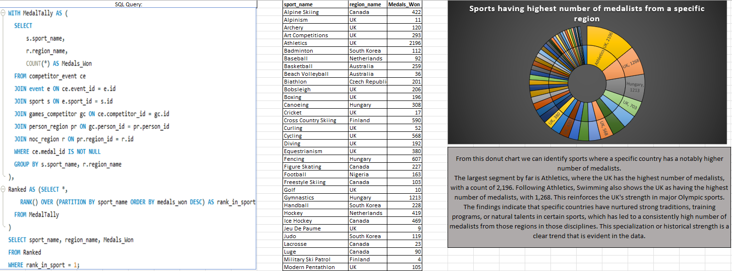
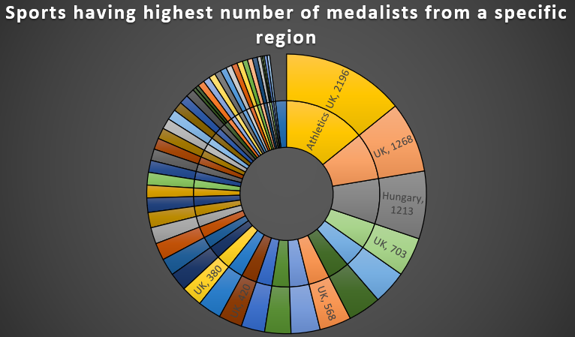
14.Are there any sports or events that have a higher number of medallists from a specific region?
The largest segment by far is Athletics, where the UK has the highest number of medalists, with a count of 2,196. Following Athletics, Swimming also shows the UK as having the highest number of medalists, with 1,268. This reinforces the UK's strength in major Olympic sports.

Slide 41
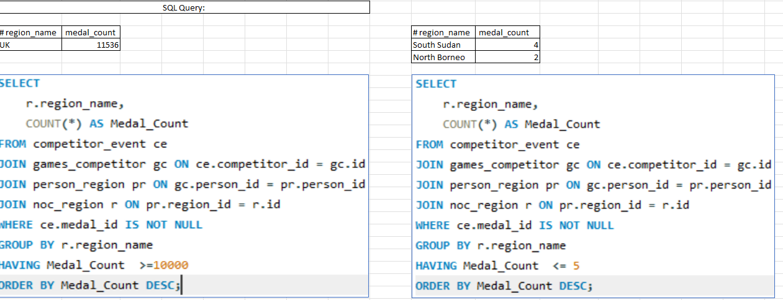
15.What are some notable instances of unexpected or surprising medal wins?
The UK's medal count of 11,536 is exceptionally high, which denotes its status as a major historical Olympic power. This is expected from a nation with a long and rich sporting history.
South Sudan is a relatively new nation, having gained independence in 2011. For such a nation to have accumulated 4 medals suggests a remarkable achievement. North Borneo's Medal Wins (2 medals): North Borneo refers to the former British colony, which is now part of Malaysia (Sabah).

Slide 42
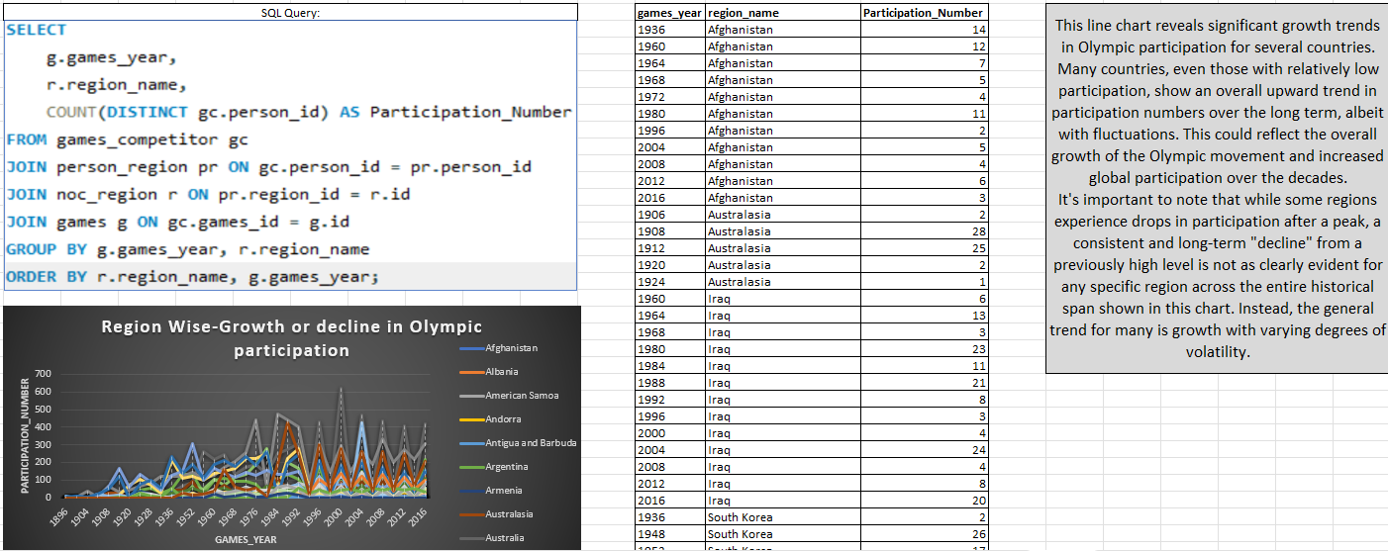
16.Are there any regions that have experienced significant growth or decline in Olympic participation?
This line chart reveals significant growth trends in Olympic participation for several countries.
Many countries, even those with relatively low participation, show an overall upward trend in participation numbers over the long term, albeit with fluctuations. This could reflect the overall growth of the Olympic movement and increased global participation over the decades.

Slide 43
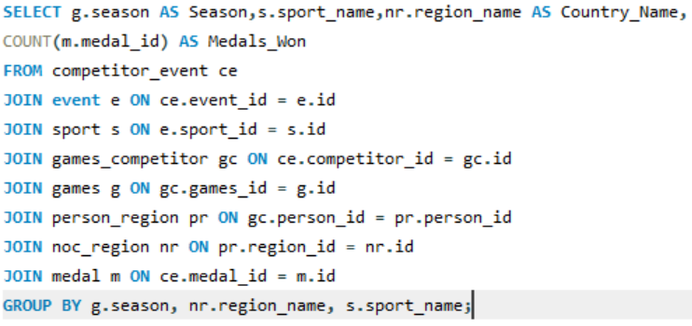
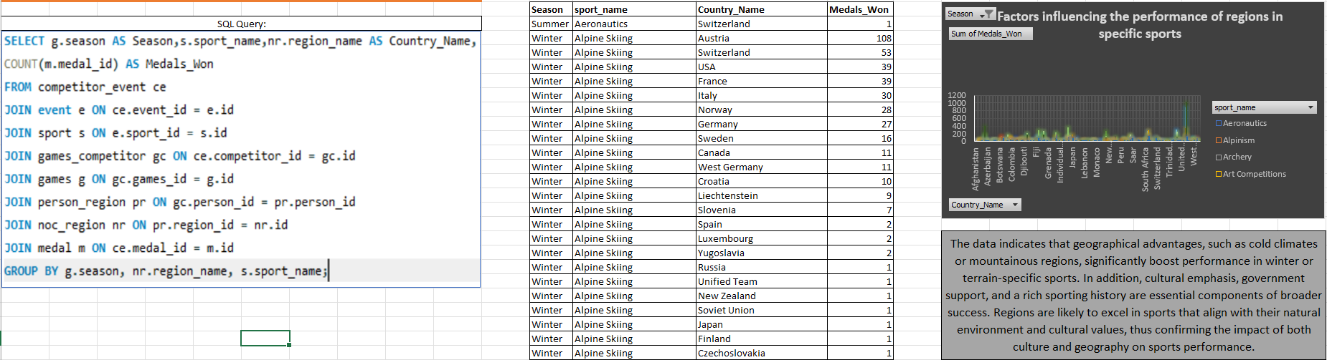
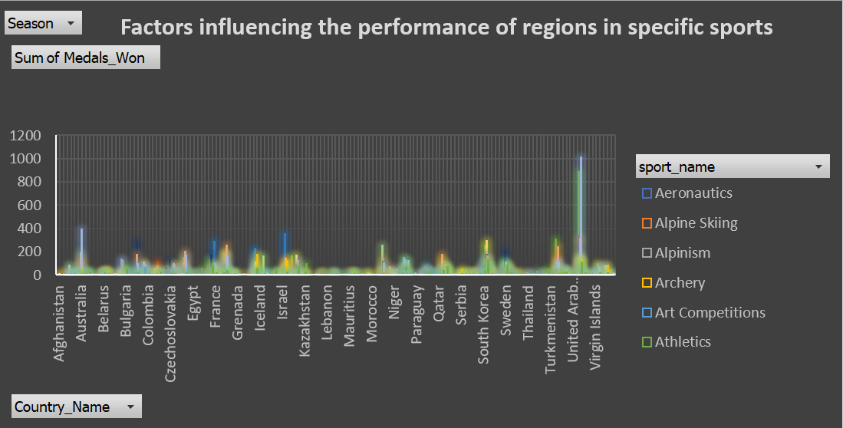
17.How do cultural or geographical factors influence the performance of regions in specific sports?
Winter-dominated sports like Ice Hockey, Cross Country Skiing and Alpinism have participants from countries like Canada, Sweden, Iceland, and Soviet Union. These sports that are naturally suited to their mountainous or snowy terrains.
Summer-dominated sports like Swimming, Fencing, Rowing, Athletics have participants from Australia, USA and UK.

Slide 44
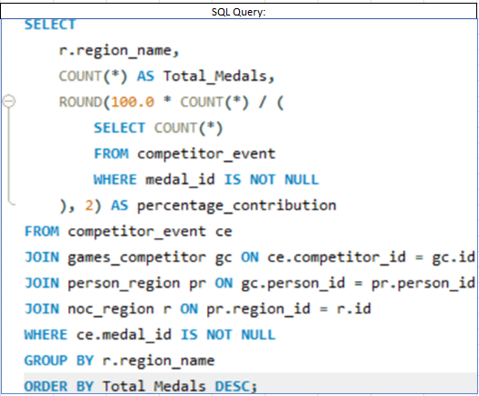
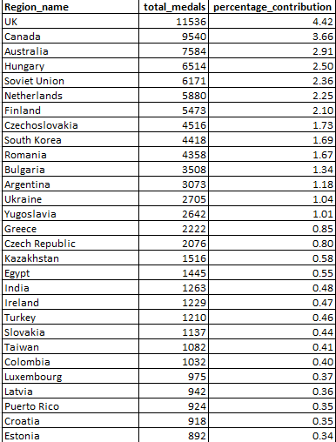
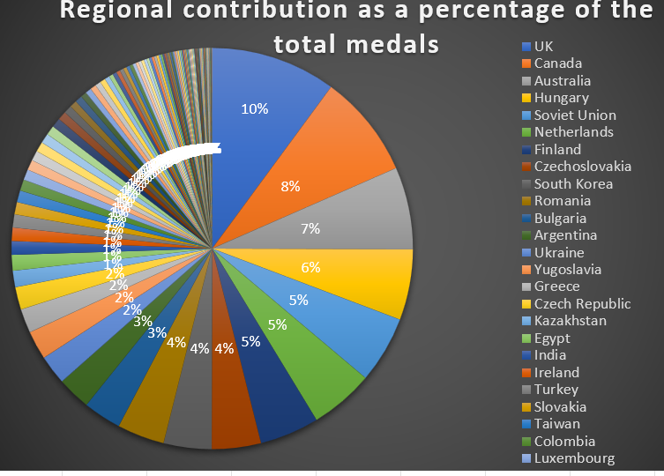
18.Are there any regions that have had a notable impact on the overall medal tally?
This Pie chart displays the percentage contribution of various regions to the total number of medals.
With 10% of the total medals, the UK stands out as the single largest contributor (nearly 10%) among the regions shown. This indicates a very significant and notable impact on the overall medal tally. Following the UK, Canada accounts for 8% of the total medals, making it another major contributor.

Slide 45

CONCLUSION
Historical data reveals a steady rise in athlete representation, gender equity advancements, and competitive parity across nations.
There is a gender domination and regional domination as far as the medal and participation is concerned.
The growing inclusion of non-traditional sports underscores the Olympics' adaptability to cultural and generational preferences, ensuring relevance in the modern era.

Slide 46
THE END

